Slide 1
Checking Legal Contracts – On a Not So Usual Application of Mechanized Logic
Stefan Leue
Software and Systems Engineering Dept. of Computer Science University of Konstanz
http://sen.uni-konstanz.de/
VardiFest 22

Slide 2
Joint Work With
Alan Khoja (Law)
Martin Kölbl (Computer Science)
Rüdiger Wilhelmi (Law)

Slide 3
Logic and Law
Leibniz, Law and Logic
G.W. Leibniz, 1669:
"In the field of legal conditions, it will be shown that certainty and proof exist in law."
(quoted after M. Armgart, Leibniz as a legal scholar, Fundamina (Pretoria). 2014, vol.20, n.1)
Later
deontic logic
defeasible logic

Slide 4
Analysis and Formalization
Our Objective: Automated Analysis
legal contracts are complex collections of claims
here: restriction to company sales purchase agreements (SPAs)
contracts change often (during contract design / negotiation phase)
need for automated consistency analysis
static / syntactic consistency (e.g., completeness of contract)
dynamic consistency analysis:
can each claim in the contract be performed individually?
does there exist at least one contract execution?
Our Approach
formalization using decidable fragments of FOL
tool-based, automated analysis using SMT-solving

Slide 5
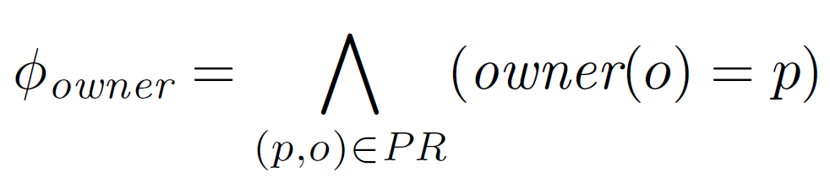
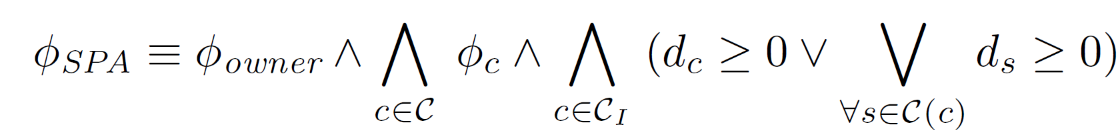
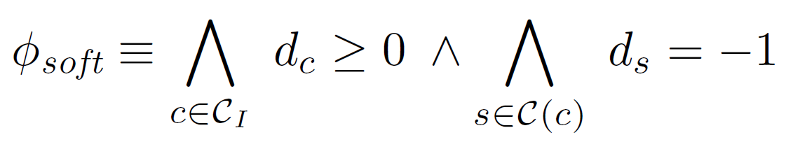

Formalization in Decidable Fragment of FOL
Legal Facts
Claims
Contract
primary / independent and consequence claims
preference on primary / independent claims: soft-assert
contract execution (partially satisfiable MaxSMT problem)

Slide 6
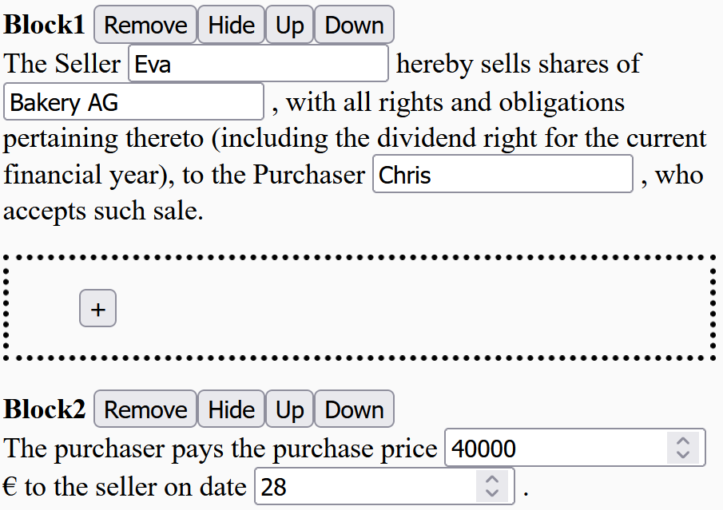
Blocks: Capturing Contract Texts
SPA §1 1.1 The Seller Eva hereby sells the shares of Bakery AG with all rights and obligations pertaining thereto (including the dividend right for the current financial year), to the Purchaser Chris who accepts such sale. 1.2 The purchaser pays the purchase price 40.000 € to the seller. 1.3 If the TransferClaim is not performed, the claim.Debtor has the right to withdraw. 1.4 If the PayClaim is not performed, the claim.Debtor has the right to withdraw. …
Parameterized Text Block
ID | Block1
Text | The Seller $seller.Name hereby sells the shares of $shares.Name with all rights and obligations pertaining thereto (including the dividend right for the current financial year), to the Purchaser $purchaser.Name who accepts such sale.
Objects | „seller:Person“, „shares:Share“, „transfer:Claim“
Assign-ments | „seller.Name=Eva“, „shares.Name=Bakery AG“, „transfer=$shares.transfer()“
Webinterface:

Slide 7
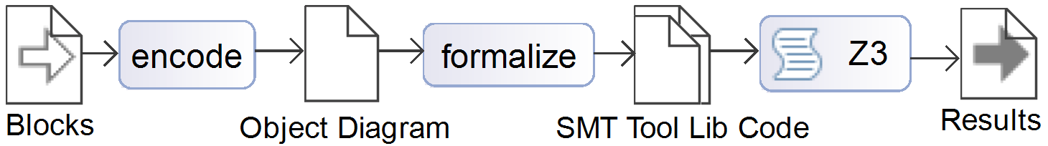
Tool ContractCheck

Slide 8

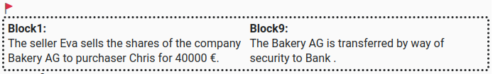
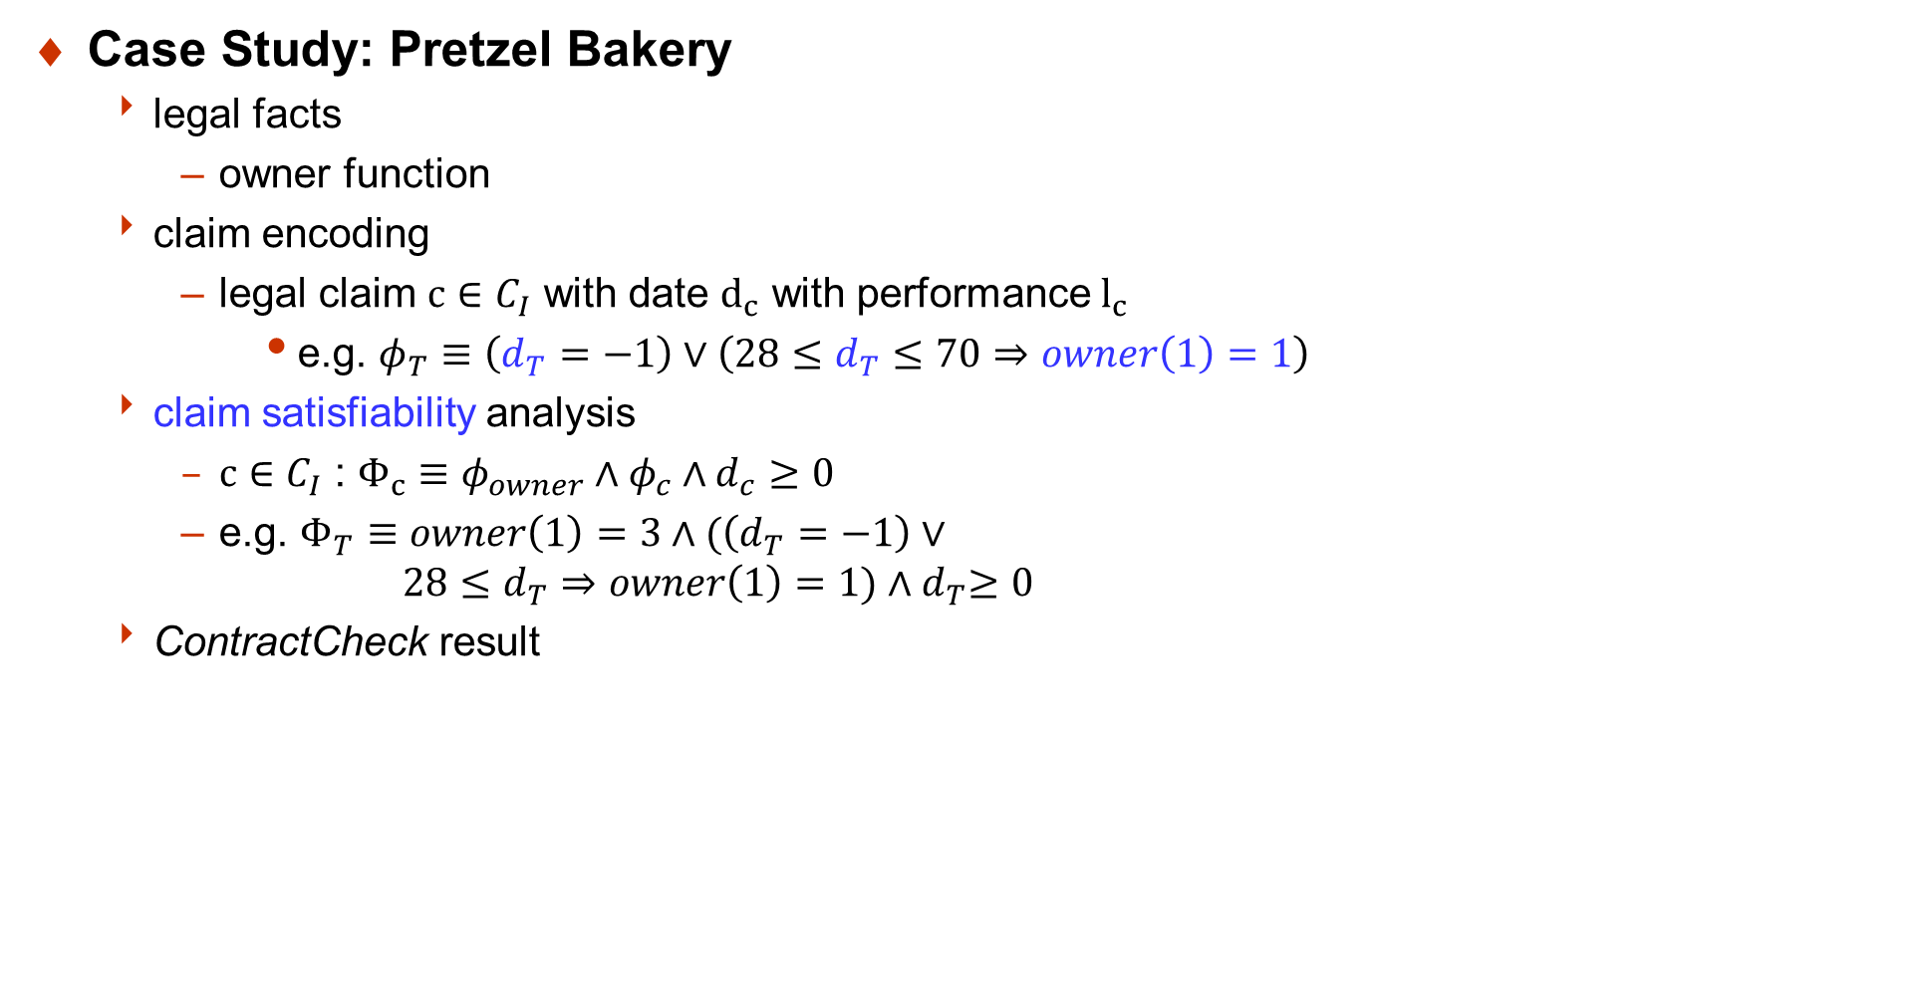
Encoding / Analysis
Case Study: Pretzel Bakery
legal facts
owner function
claim encoding
legal claim $c∈C_{I}$ with date $d_{c}$ with performance $l_{c}$
e.g. $φ_{T}≡\left(d_{T}=−1\right)∨\left(28≤d_{T}≤70⇒owner\left(1\right)=1\right)$
claim satisfiability analysis
$c∈C_{I}$ : $Φ_{c}≡φ_{owner}∧φ_{c}∧d_{c}≥0$
e.g. $Φ_{T}≡owner\left(1\right)=3∧(\left(d_{T}=−1\right)∨$ $28≤d_{T}⇒owner\left(1\right)=1){∧d}_{T}≥0$
ContractCheck result

Slide 9
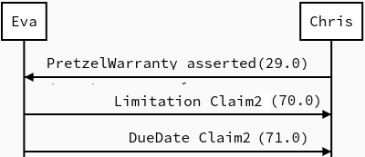
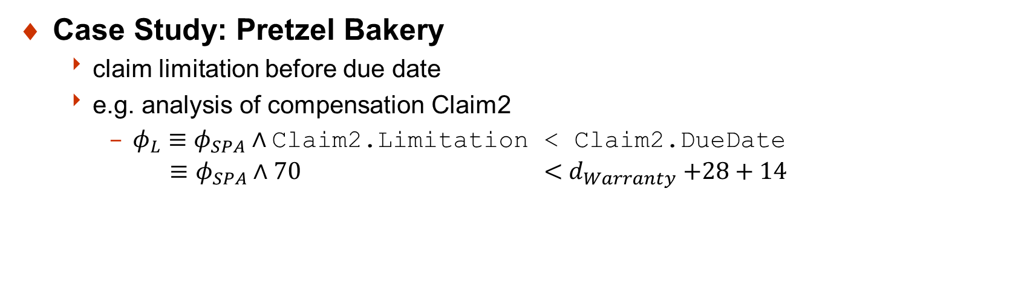
Encoding / Analysis
Case Study: Pretzel Bakery
claim limitation before due date
e.g. analysis of compensation Claim2
$φ_{L}≡φ_{SPA}∧\text{Claim}\text{2.}\text{Limitation}\text{ < }\text{Claim}\text{2.}\text{DueDate}$ $≡φ_{SPA}∧\text{70} \text{<} d_{Warranty}\text{ +28 + 14}$

Slide 10
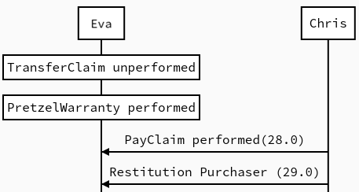


Encoding / Analysis
Case Study: Pretzel Bakery
existence of contract execution?
legal claim set $C$
independent claim $T∈C_{I}$
consequence claim $WT∈C\left(T\right)$
e.g. $φ_{WT}≡\left(d_{WT}=−1\right)∨$ T.DueDate $<d_{WT}$
analysis
$φ_{SPA}≡φ_{owner} \bigwedge_{c∈C}{φ_{c}} \bigwedge_{c∈c_{I}}{(d_{c}≥0}\bigvee_{c^{′}∈C\left(c\right)}{d_{c}^{′}≥0})$
Notes:
withdraw

Slide 11
Conclusion
What we've learned
mechanized logic can be very effective in reasoning about domains other than software and systems
in particular SMT, since it allow us to combine domain-specific constraints
automation is key
What we're planning to do
state machine models for dynamic contract execution
more complex contracts
Where more can be found:
Alan Khoja, Martin Kölbl, Stefan Leue and Rüdiger Wilhelmi. Automated Consistency Analysis for Legal Contracts. Proc. SPIN 2022. Vol. 13255 of LNCS. Springer Verlag, 2022. To appear.

